Slide 1




Slide 2
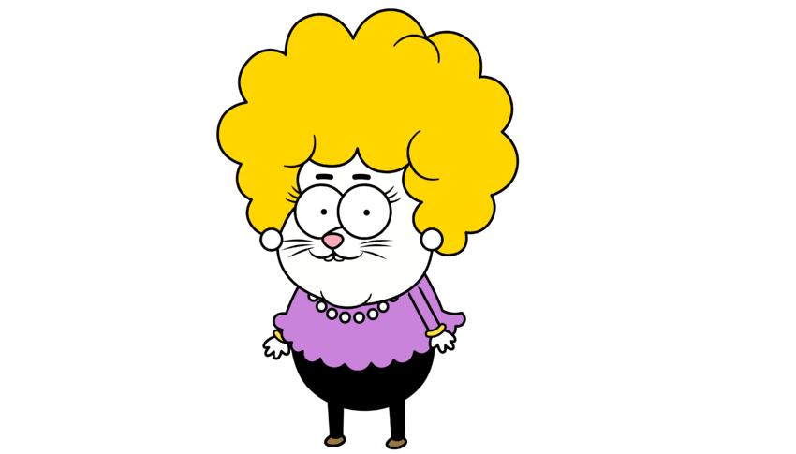
WHO IS SHE?
SHE IS KADRİYE.

Slide 3
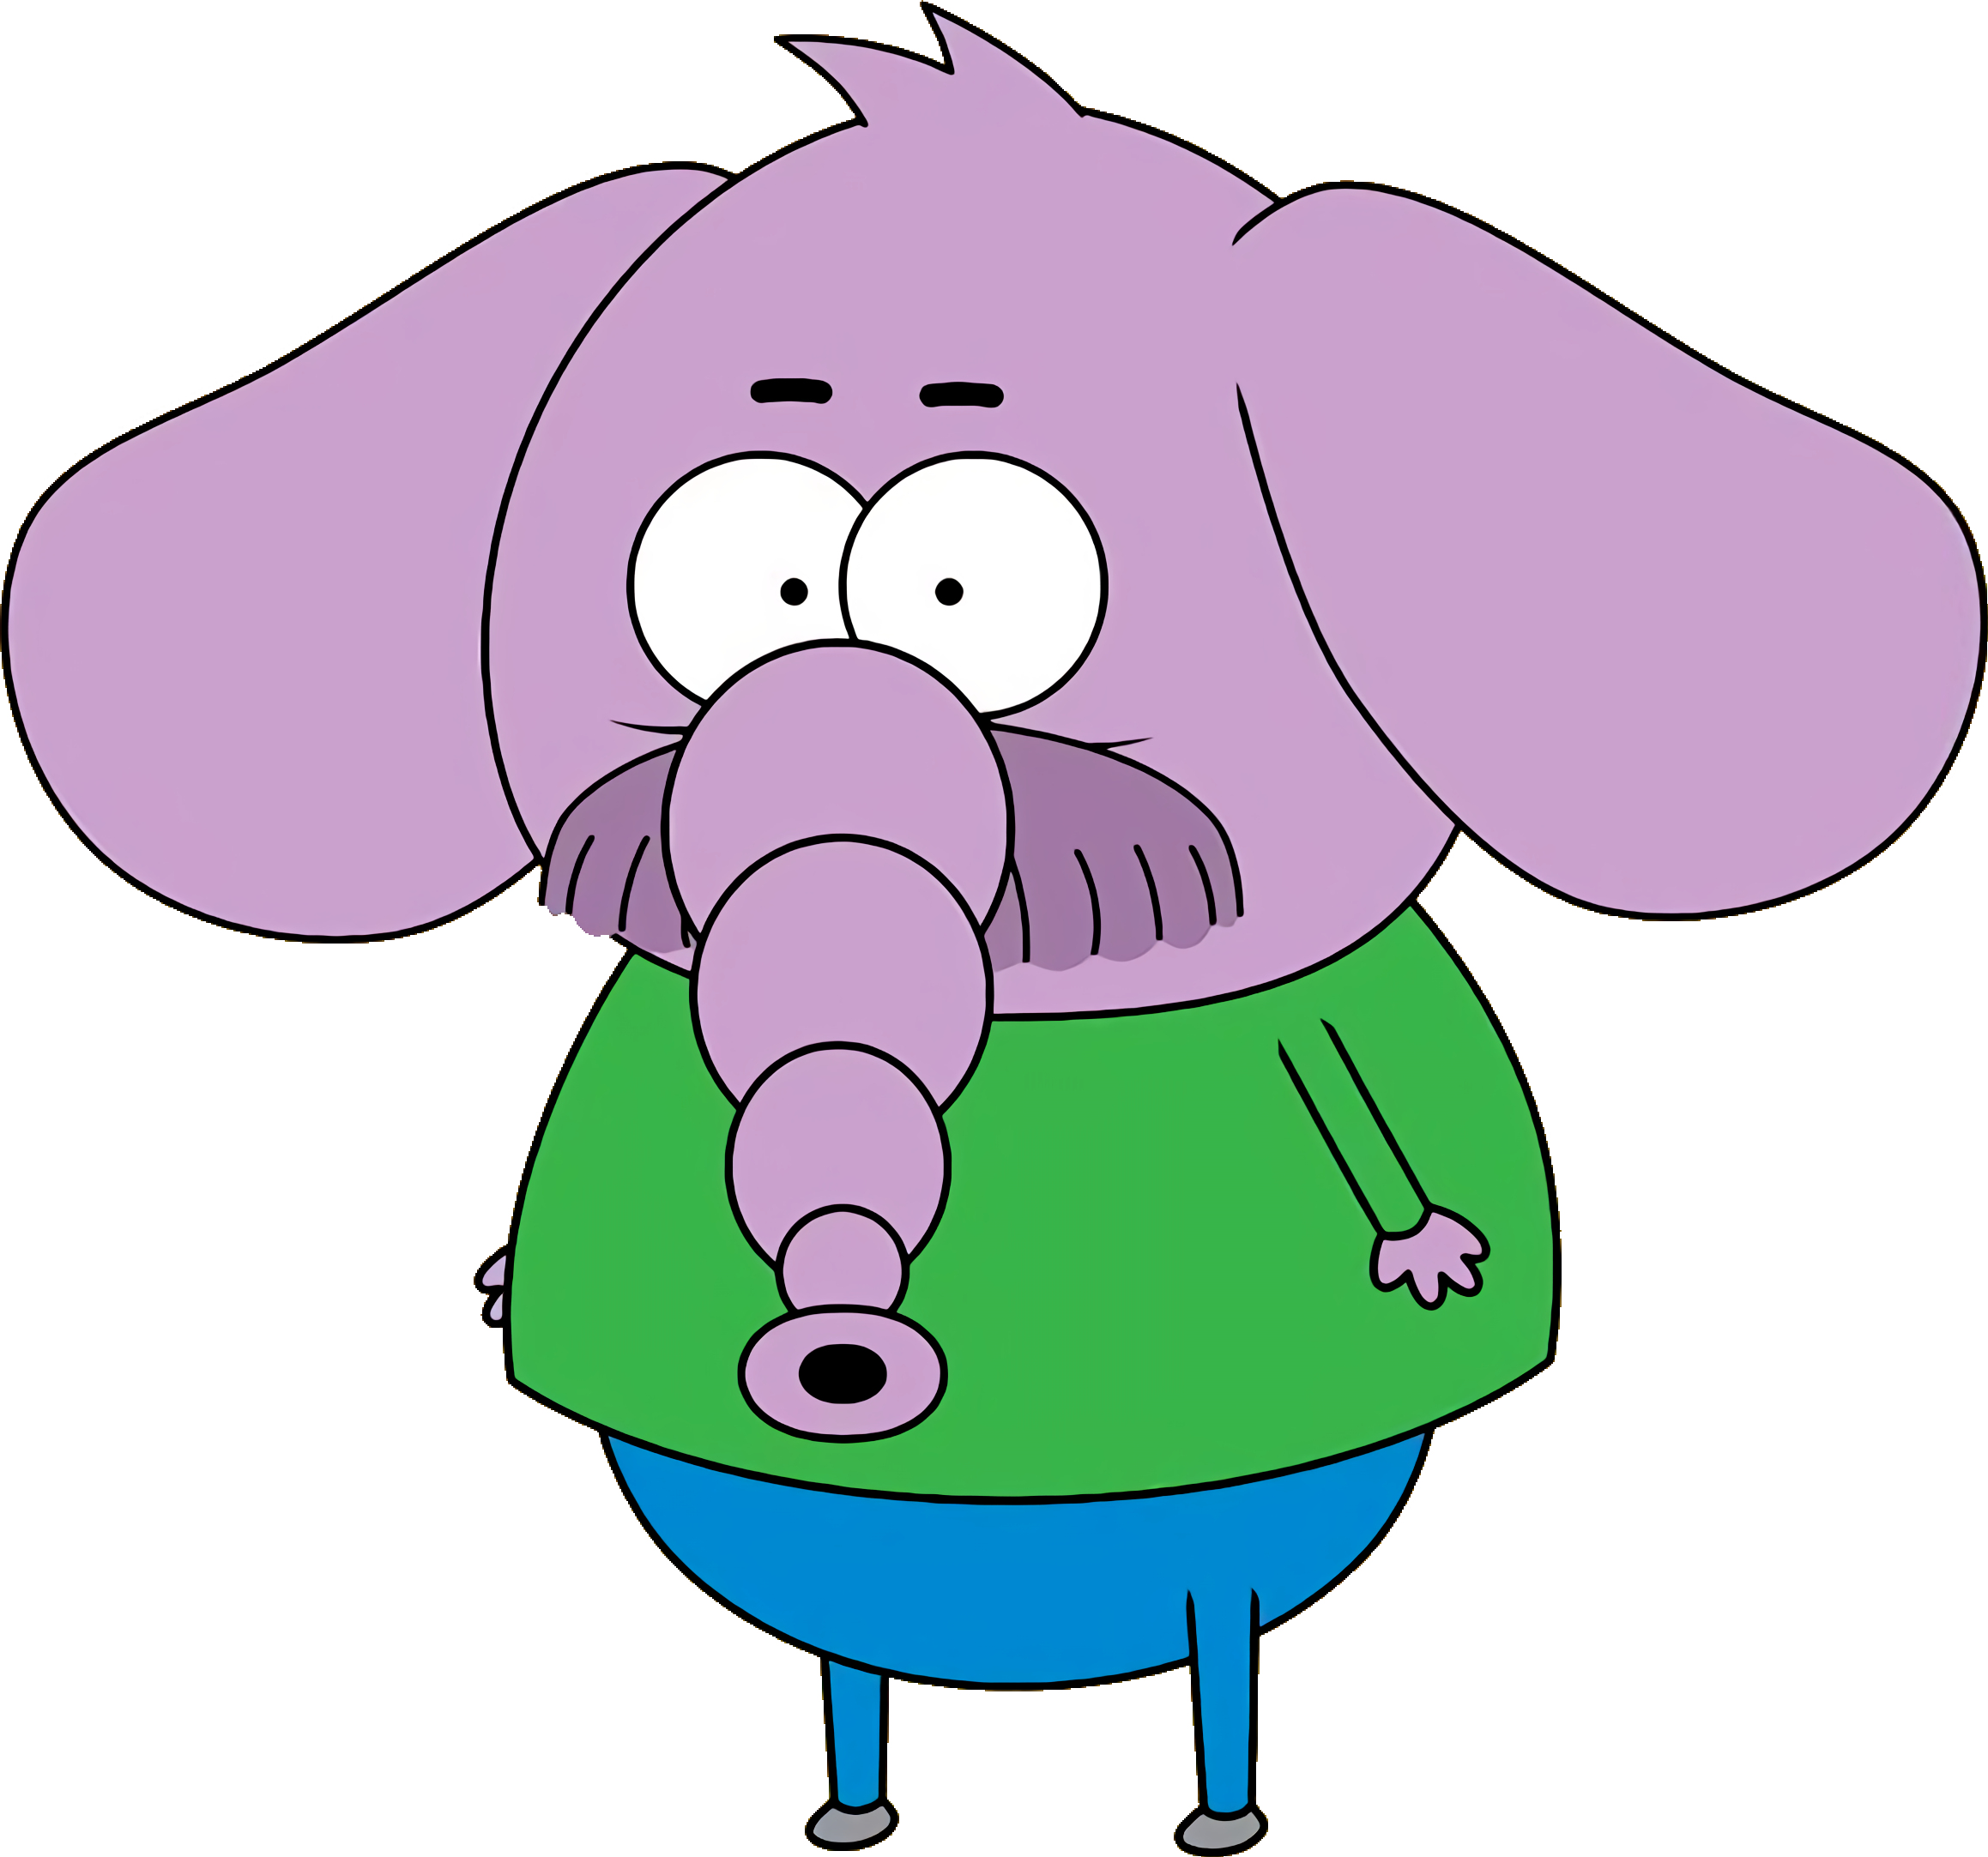
WHO IS HE?
HE IS NECATİ.

Slide 4
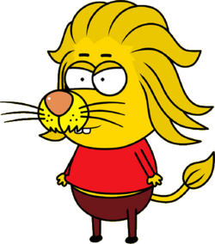
WHO IS HE?
HE IS REMZİ.

Slide 5

WHO IS SHE?
SHE IS CANAN.

Slide 6

WHO IS HE?
HE IS ŞAKİR.

Slide 7
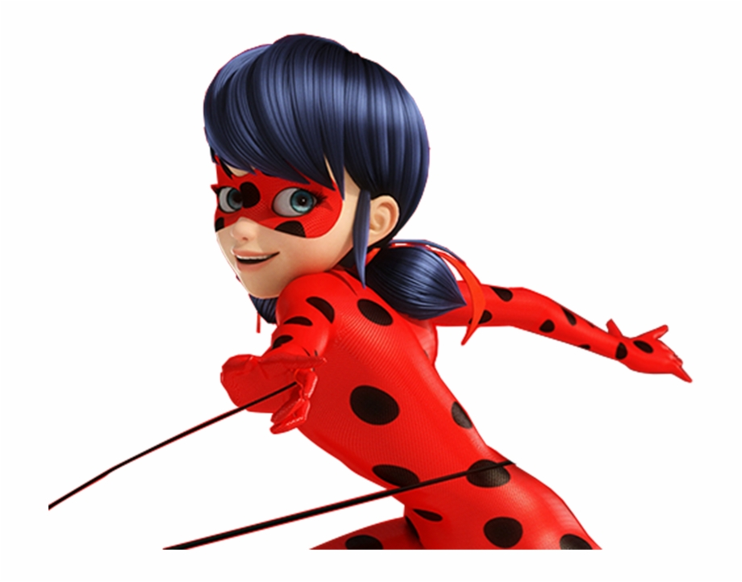
WHO IS SHE?
SHE IS MIRACULOUS LADYBUG.

Slide 8
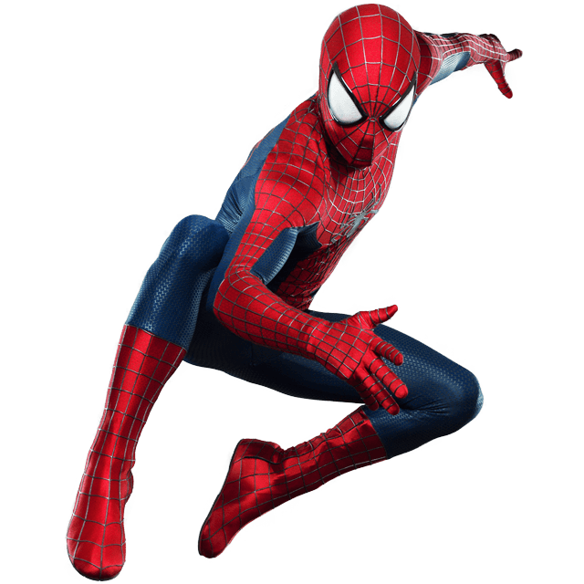
WHO IS HE?
HE IS SPIDERMAN.

Slide 9
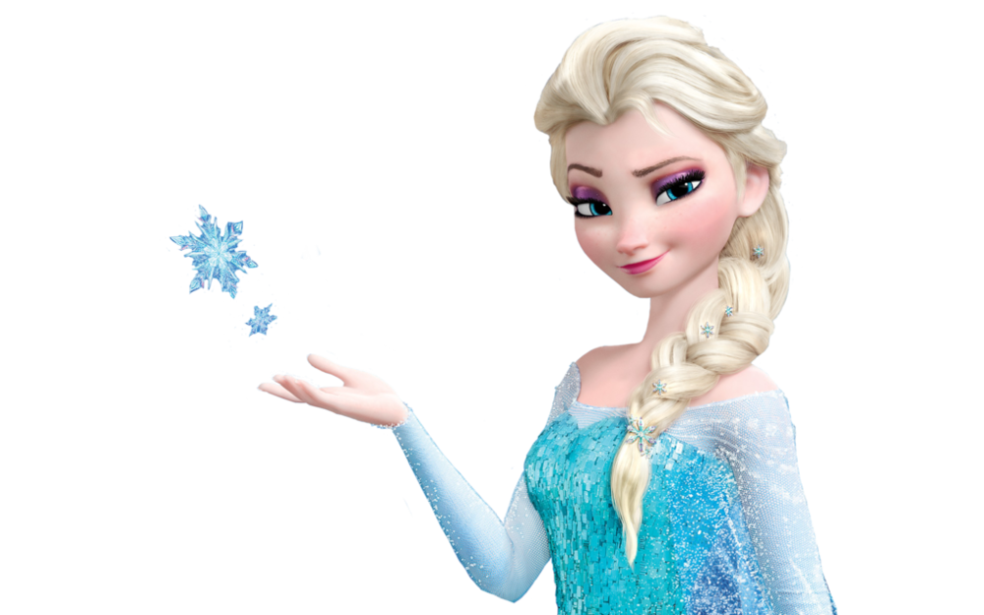
WHO IS SHE?
SHE IS ELSA.

Slide 10
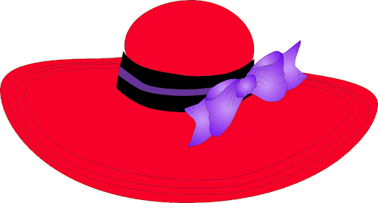



Slide 11
HE / SHE IS KADRİYE.
HE / SHE IS NECATİ.
HE / SHE IS ŞAKİR.
HE / SHE IS CANAN.
HE / SHE IS REMZİ.
HE / SHE IS SPIDERMAN.
HE / SHE IS ELSA.
HE / SHE IS MIRACULOUS LADYBUG.

Slide 12




